Slide 1


Final Project: FIFA World Cup Analysis (1930 – 2022)
DEPI Final Project
Team Members:
Sameh Mahmoud Mahmoud
Kamilya Abdelnaser Ahmed
Mohamed Helmy Fadel

Slide 2
Introduction
The FIFA World Cup is one of the most prestigious and globally followed sporting events. Since it began in 1930, it has brought together the best football nations every four years to compete for the ultimate title. The World Cup has not only shaped the history of football but also mirrored significant social, political, and economic changes around the world. With iconic matches, unforgettable goals, and legendary players, it has captivated millions of fans across generations. This analysis, covering the tournament’s entire history from 1930 to 2022, seeks to provide a clear understanding of key moments, performance trends, and important milestones in the evolution of the World Cup.

Slide 3
Agenda
Problem Statement
Objective
Data and Methodology:
Data Sources
Tools Used
Initial Research
Analysis phases:
Phase one: Ask Questions
Phase two: Collect and Prepare Data
Phase three: Date Cleaning – Manipulation
Phase four: Analyze Data
Phase five: Visualize and present Data
Result
Conclusion
Limitation and Future Work

Slide 4

Problem statement
With such a long history and a wealth of data available, understanding key insights from over 90 years of World Cup tournaments can be overwhelming, and there isn’t an easy way to explore or interact with this data in a meaningful way. It’s not just about who won or who scored the most goals; it's about uncovering trends, patterns, and hidden stories that can give us a deeper understanding of team performances and the tournament’s evolution. The challenge lies in transforming this vast data into meaningful insights that can be easily understood and visually explored.

Slide 5


Objective
The main objective of this project is to provide an interactive and comprehensive dashboard that analyzes the performance of countries, players, and tournaments over the years. We aim to simplify the complex data into visually appealing insights, focusing on final match details, top scorers, and country-specific performance. Ultimately, the goal is to offer a dynamic tool that can be used to explore the rich history of the FIFA World Cup and provide answers to questions both fans and analysts may have.

Slide 6

Data and Methodology

Slide 7




1.Data Sources
FIFA Website:
The official website of FIFA, providing reliable tournament information, match results, team rosters, and historical records from all World Cup events.
Transfer Market:
A comprehensive platform for player and team statistics, offering insights into player performances, market values, and historical data related to football clubs and international teams.
Kaggle:
A community-driven platform that hosts datasets on various topics, including football, offering historical match data, player statistics, and user-contributed analyses for deeper insights.
GitHub:
A platform for sharing code and data analysis scripts, featuring repositories with tools and methodologies used by developers and data analysts in football analytics.

Slide 8





2.Tools Used

Slide 9
Initial Research
Before starting to ask specific questions, we needed to understand more about the FIFA World Cup, so we began by conducting some initial research. This helped us shape the direction of the project and come up with the right questions
Note: Our first milestone was to dedicate a day to conducting research on the FIFA World Cup.

Slide 10





Analysis Phases
Ask Questions
Collect and Prepare Data
Date Cleaning – Manipulation
Analyze data
Visualize and Share Data

Slide 11

Phase1: Ask Questions
Key Questions:
Total Goals Over the Years
How have total goals scored evolved across World Cup tournaments?
How has the tournament's match structure impacted the number of goals scored?
Number of Unique Winners
How many different countries have won the FIFA World Cup?
Countries That Hosted the World Cup
Which countries have hosted the World Cup the most times?
Total Matches Played in All World Cups
What is the total number of matches played in World Cup history?
Top Performing Countries
Which countries have consistently performed the best across all World Cup tournaments?
Second Milestones : We completed this phase within 1 day

Slide 12
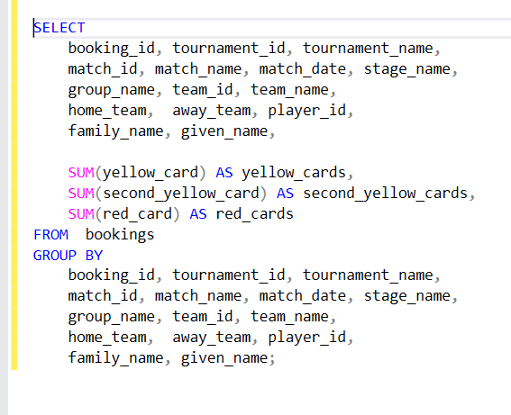
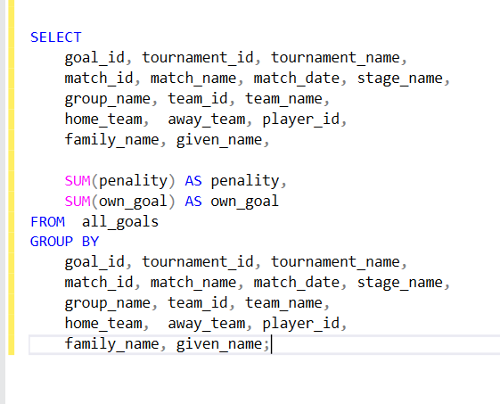
Phase 2: Collect and Prepare Data
Data Collection:
We gathered data from trusted and authoritative sources, including the official FIFA website, sports databases, and historical records. These sources ensured the accuracy and reliability of the data for our analysis.
Data Organization:
Most of the data was further refined and organized using spreadsheets. This allowed us to reformat the information and streamline it for easier handling and analysis throughout the project.
At various stages, we used SQL to efficiently extract, organize, and prepare data directly from databases. This helped ensure the data was structured and ready for analysis.
Third Milestone:
This phase is planned to be completed within 2 days.

Slide 13

Phase3: Date cleaning – Manipulation
Removed Duplicates: Identified and eliminated duplicate records to ensure a reliable and precise analysis.
Handled Missing Values: Checked for nulls across columns and handled them appropriately, depending on their relevance to the analysis.
Separated Columns: Split specific columns to enhance clarity for business cases, such as modeling.
Correcting Data Inconsistencies for Accuracy
We corrected inconsistencies in player second names to ensure uniformity and maintain data accuracy.
Removed Unwanted Columns: Deleted irrelevant columns to keep the dataset focused, clean, and relevant to our objectives.
Organized Data: Structured the dataset to optimize for efficiency and accurate analysis.
Fourth Milestone :
This phase is projected to be completed within 3 days.

Slide 14
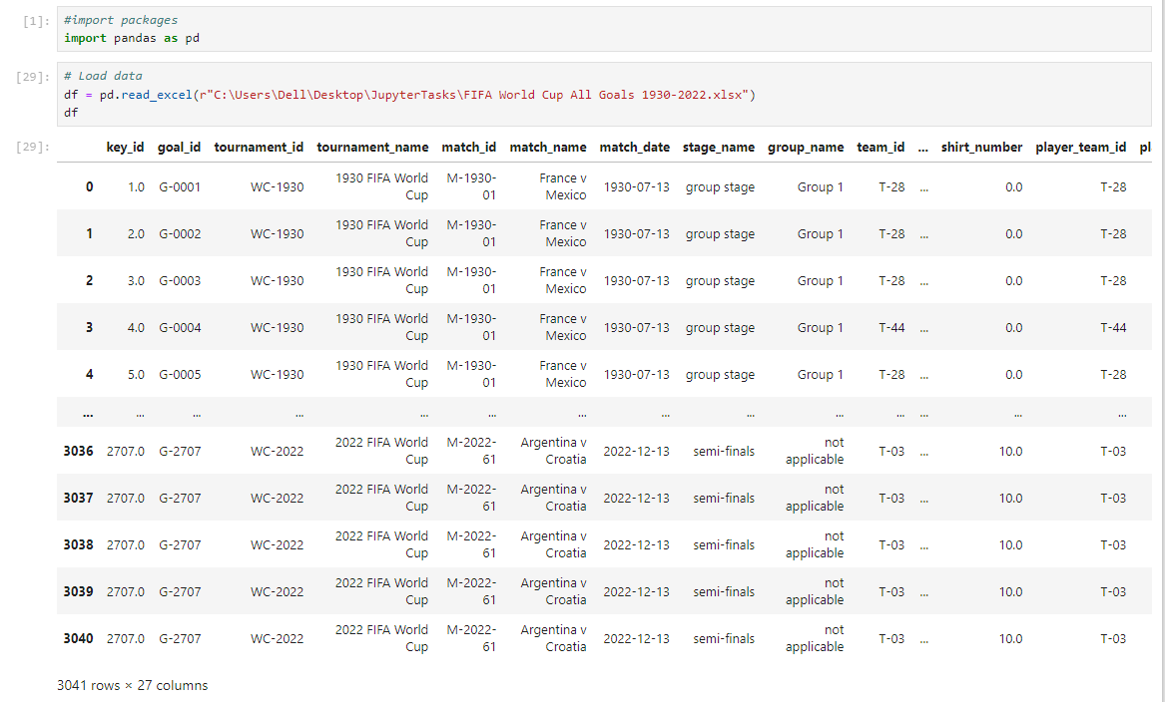
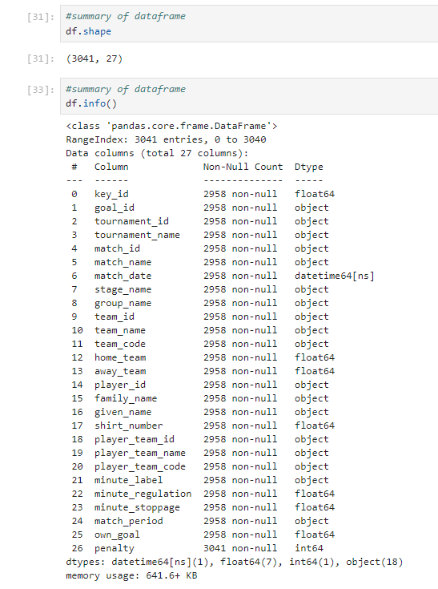
Phase3: Date cleaning – Manipulation (Python)

Slide 15
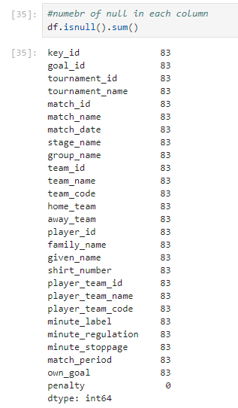
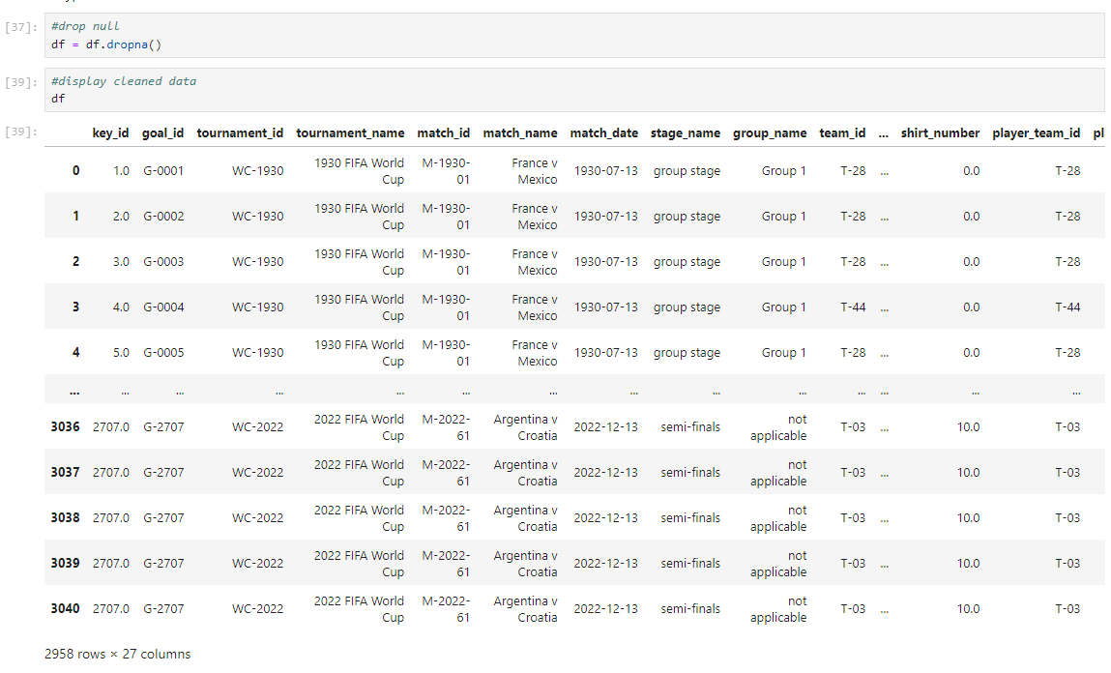
Phase3: Date cleaning – Manipulation (Python)

Slide 16
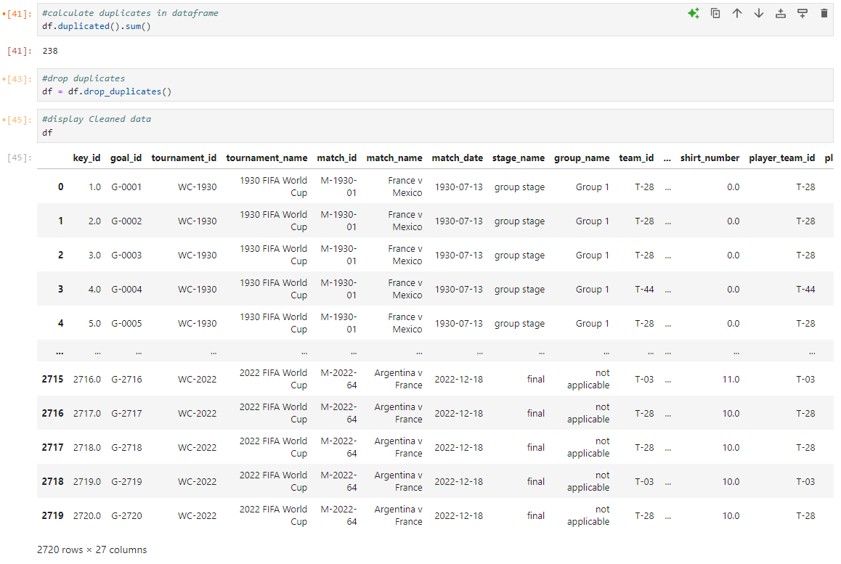
Phase3: Date cleaning – Manipulation (Python)

Slide 17
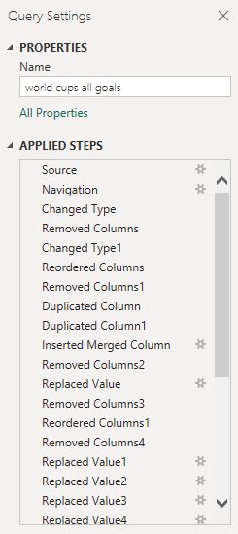
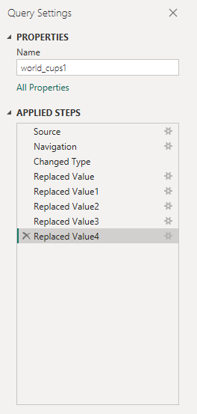
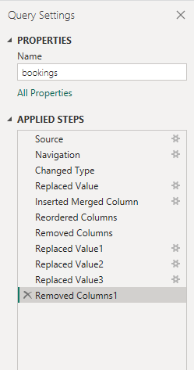
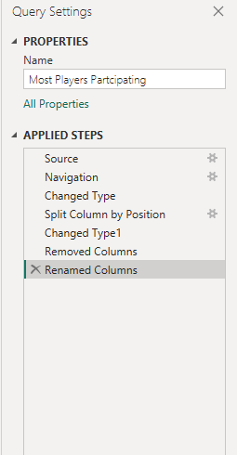
Phase3: Date cleaning – Manipulation (Power Query)

Slide 18
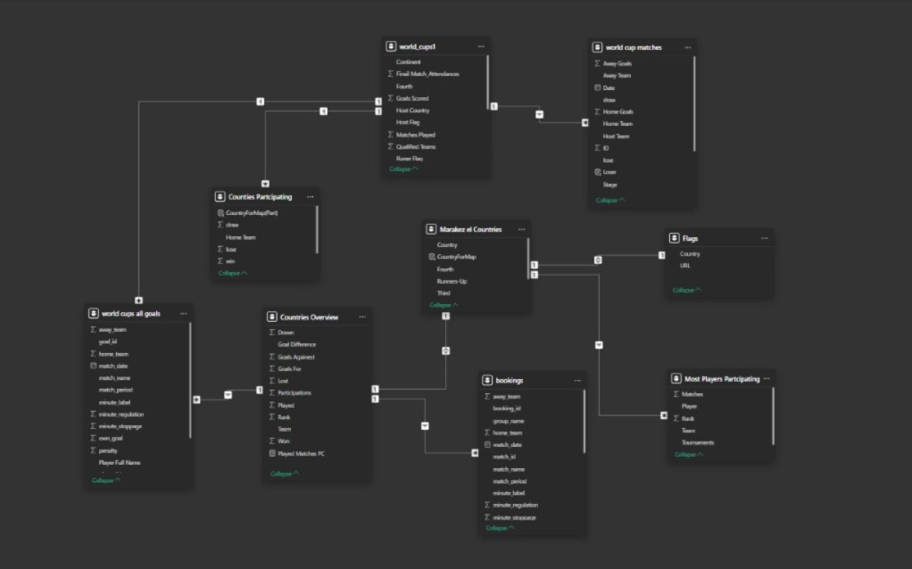
Phase 4: Analyze Data (Data Modeling)
Data modeling helps organize information: It creates a clear structure for how data is arranged and how different pieces of information are connected.
It ensures data quality: By defining key elements and their relationships, data modeling makes sure the data is accurate and consistent.
It aids decision-making: A good data model allows organizations to understand their data better, leading to more informed decisions and valuable insights.

Slide 19
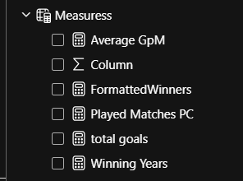
Phase 4: Analyze Data
Answering Key Questions:
We began by addressing the main questions we defined earlier. These questions guided our data exploration
Creating Measures for Analysis: To gain deeper insights, we created several key measures
Highlighting Important KPIs:
The analysis brought out critical insights, with KPIs
These insights were presented using visualizations to highlight the most critical trends and key metrics that inform the broader story of the FIFA World Cup.
Fifth Milestone: This phase is projected to be completed within 4 days.
Sample of DAX measures

Slide 20
Phase 5: Visualize and Present Data
Transitioned to presenting insights using Power BI for interactive and dynamic visualizations.
Carefully selected chart types to match the data, ensuring the perfect style to present information in a clear and user-friendly manner.
Designed visualizations to maximize comfort and ease of interpretation for users.
Enabled users to explore key FIFA World Cup metrics interactively, such as total goals, winning teams, and host countries.
Used bar charts, line charts, and maps to deliver insights while focusing on the most important KPIs with maximum clarity and impact.
Sixth Milestone
This phase is projected to be completed within 4 days.

Slide 21
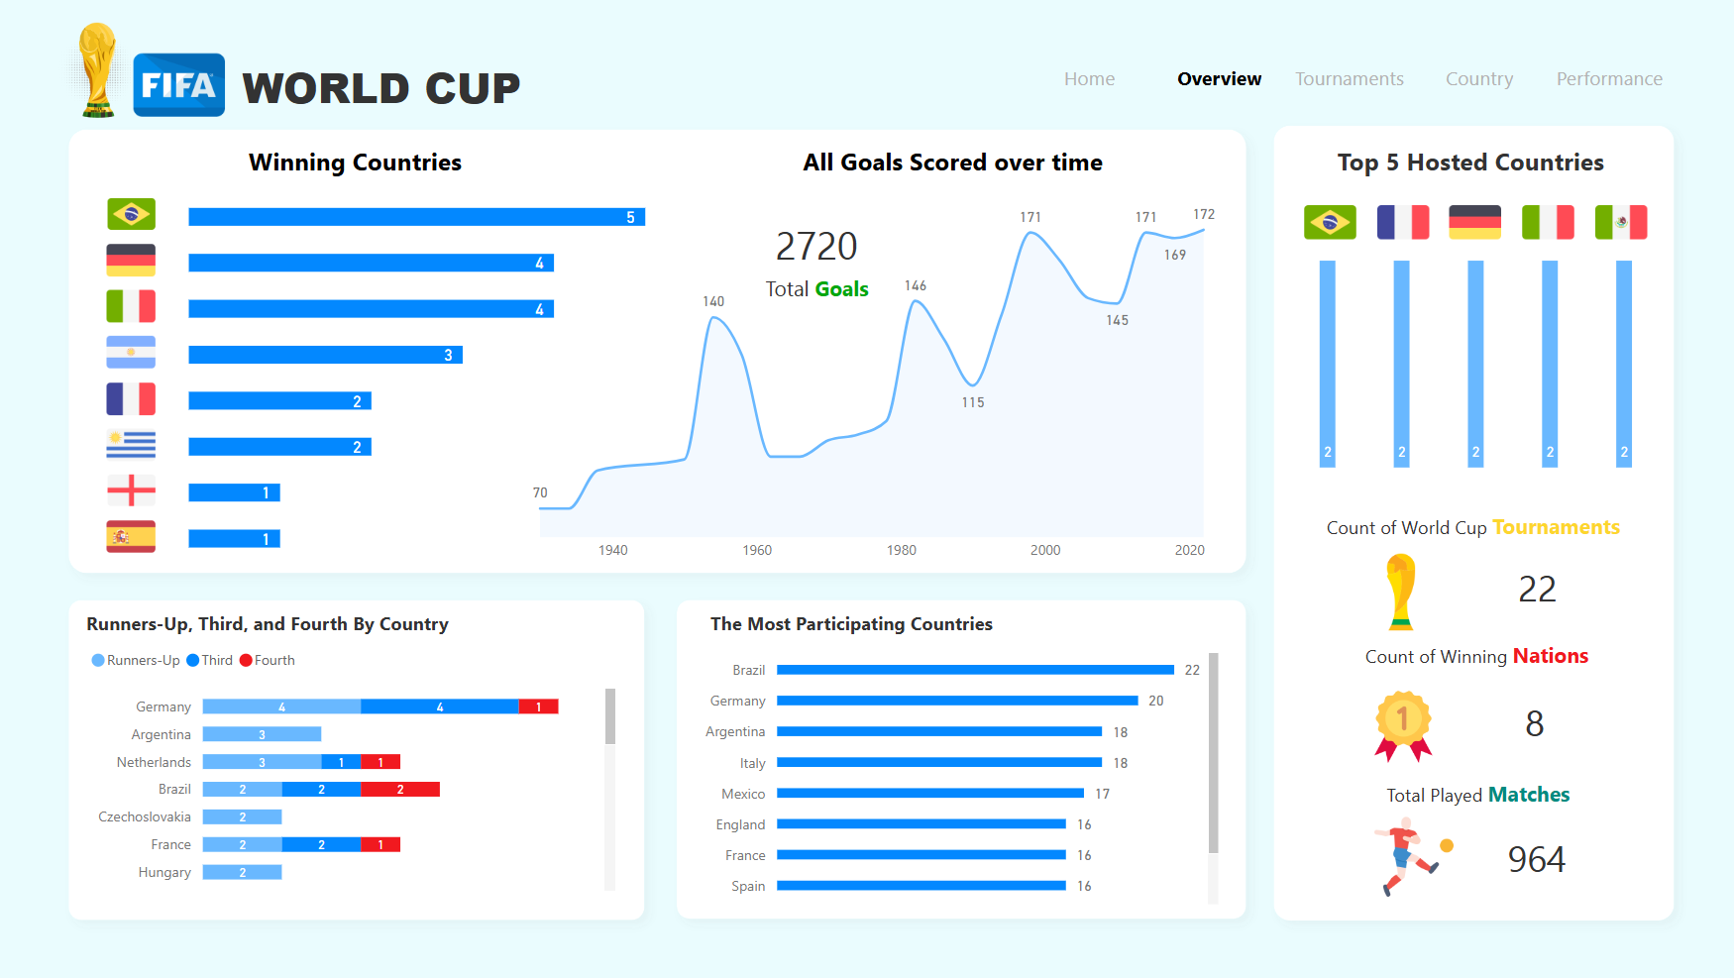
Overview Page
Total goals scored over time
Top hosted countries.
Winner Countries by total world Cups
Runners-up, Third and fourth by total world cups
Total World Cups
Distinct count of winner
Total matched in all FIFA World Cups
Top 10 participating countries

Slide 22
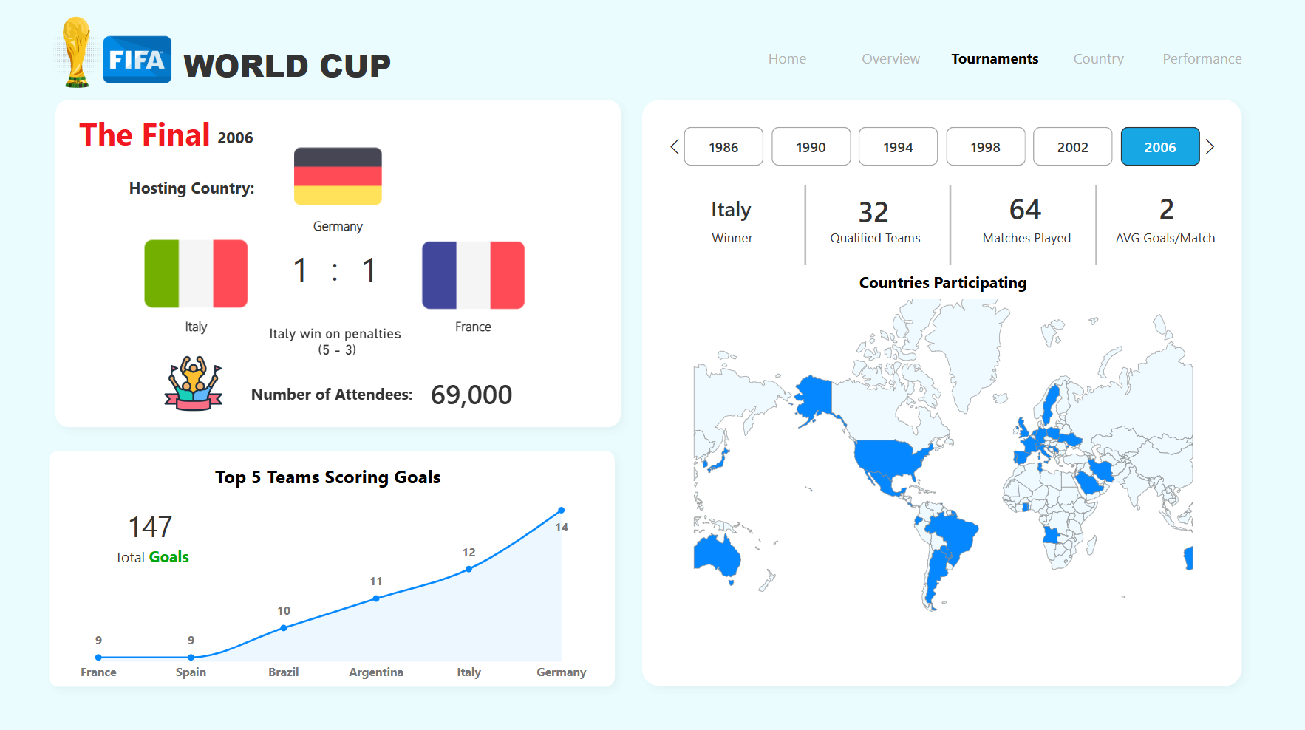
Tournaments Page
The slicer allows users to filter and visualize data based on specific World Cup years.
This section presents:
The Winner
Total Qualified teams
Total matches played
Avg Goal
This section presents:
Overview of the final matches along with the match results.
The total number of attendees.
Top 5 team scoring Goals
Countries participating Map

Slide 23
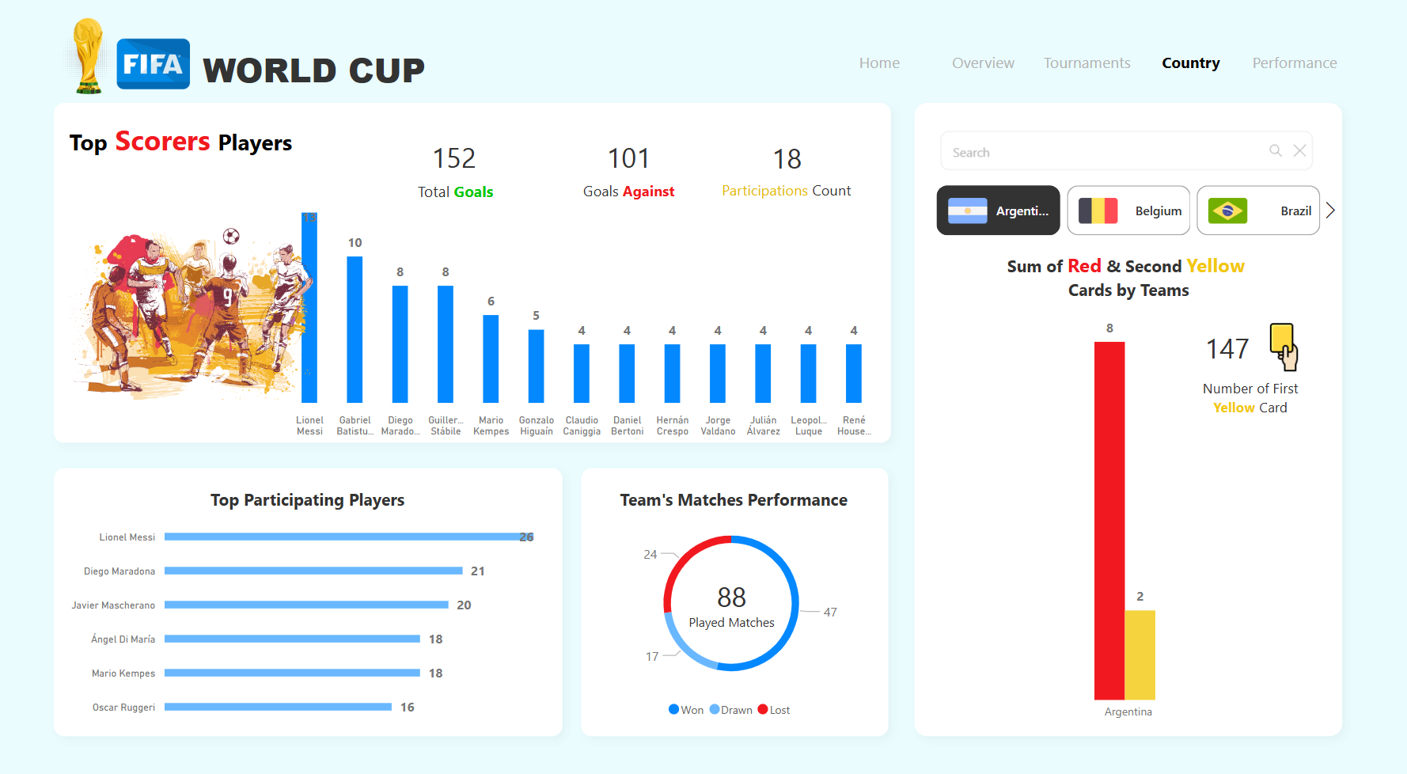
Country Page
Country Search Bar: Filter data for specific countries.
Top Countries Slicer: Visualize data for top World Cup participants.
Top scorer players
Total goals scored
Total goal Against
Total Participating
Top participating players by Country
Display each team's performance based on the number of wins, draws, and losses in Matches.
Total Second Yellow and Red Cards by Country.
Total First Yellow Card by Countries

Slide 24
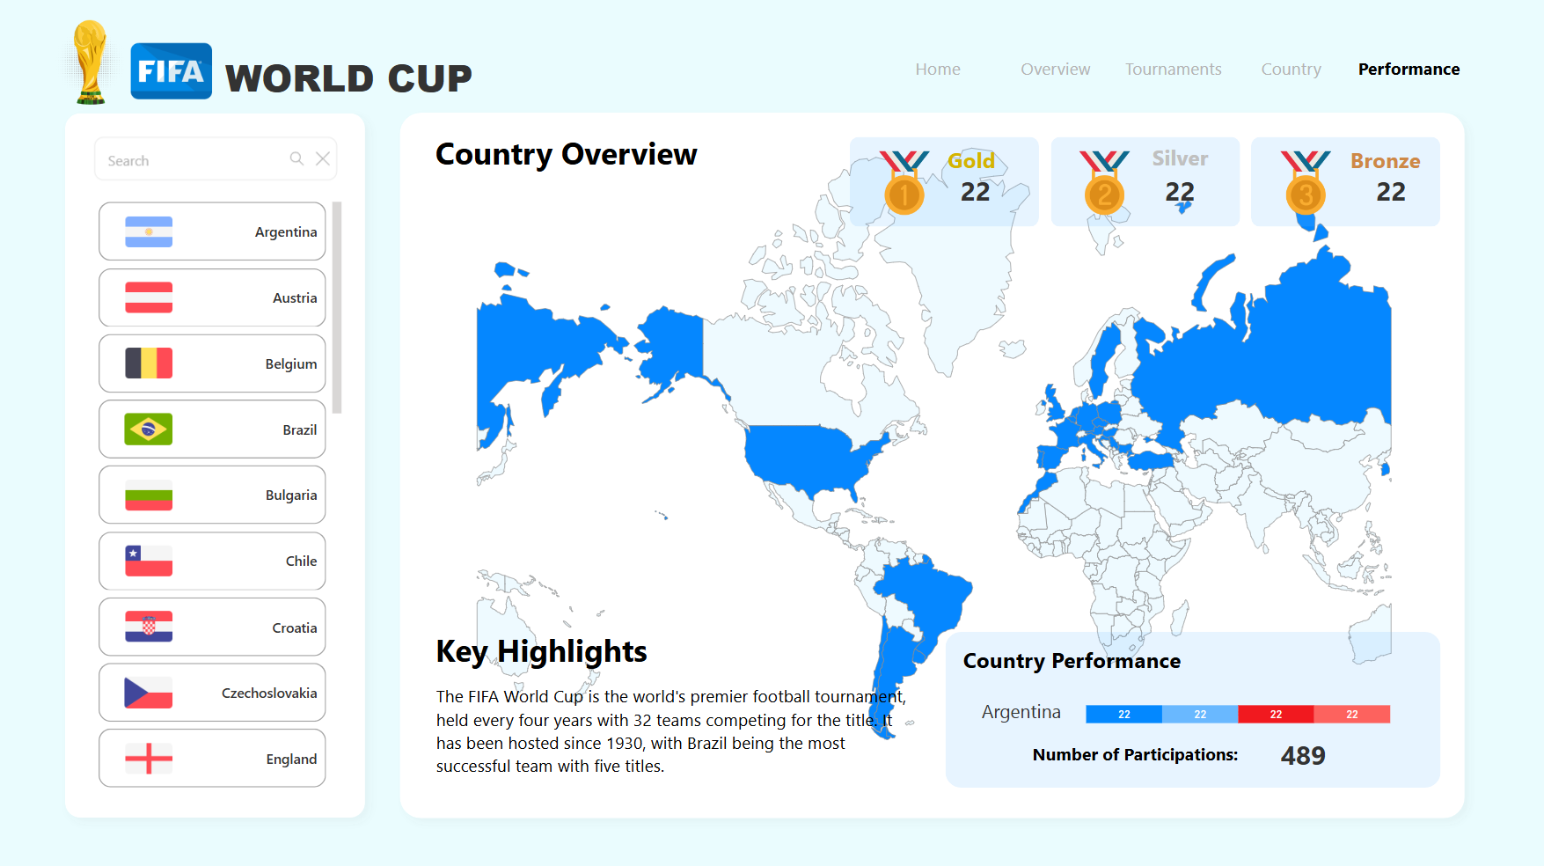
Performance Page
Counties overview Map
Total Golden, Silver, Bronze Medals
Country Search Bar: Filter data for specific countries.
Top Countries Slicer: Visualize data for top World Cup participants.
Country performance and number of Participations

Slide 25

Conclusion
Most Successful Country: Brazil is the country with the most World Cup wins.
Finals Participation: Germany has played in the most finals and ranks second in total World Cup victories.
Total Goals Scored: Across all World Cups, there have been 2,720 goals scored.
The 2022 World Cup had the highest total with 172 goals.
The 2014 and 1998 World Cups each had 171 goals.
Most Participating Countries: Brazil is the country with the most World Cup participations, followed by Germany.
Growth of Participation: The number of countries participating in the World Cup has grown from 16 to 32.
Highest Attendance: The 1950 World Cup had the highest total attendance for a final, with the 1986 World Cup coming in second.
Miroslav Klose holds the record for the most goals scored in World Cups.
Ronaldo ranks second in total goals.
Most Participating Player: Lionel Messi is the player with the most World Cup
Disciplinary Records: Argentina consider the one of the most aggressive country has received the most yellow and Red card cards in World Cup history.

Slide 26
Limitations and Future Work
Incomplete Player Data: Limited availability of comprehensive data on all players across World Cup teams restricted our ability to create detailed filters for every country.
Missed Penalties: We could not perform an in-depth analysis of missed penalties, which are critical in understanding match outcomes.
Limitations
Player Data Enhancement: Future work could focus on gathering more complete player data to allow for deeper country-level analysis.
Penalties Analysis: Expanding the dataset to include missed penalties would enable a more detailed study of this crucial game factor.
Future Work

Slide 27

Thank you for your attention!
Special thanks to our great Instructor Amira Shahin for her invaluable guidance throughout this Intuitive

Slide 28

Q&A
Invite Questions: Open the floor for questions and discussions.

